Slide 1
G-Control
An IOT based car using hand gestures to move around.
Submitted By:
Saksham Kumar 16ESKCS747
Shashank Pant 16ESKCS751

Slide 2
Table of Contents
Problem Domain
Proposed Logic
Scope of Project
Technology Used
Hardware Description
Working Flow
Future Aspects
References
1

Slide 3
Problem Domain
Military
There is a major need of efficiency and swiftness in the field which is very difficult to maintain when the soldier’s hands are full.
There is a need of gadgets that require very less control engagement and can be controlled without any complex controls.
Medical Assistance
There are millions of people struggling to move on their on or move
things in their vicinity. This proposed device can help these people in
moving without having to do complex movements thus saving them
from tedious tasks and chores.
It is far easier to operate gadgets without any complex movements when it comes to the controls and engagement. Thus gesture control can be proven to be a good alternative.

Slide 4
Proposed Logic
We mainly have focused on reducing the engagement of the hand which can be a deal breaker in military applications where the efficiency of a soldier matter the most or for people who are handicapped by giving them the ability to control their environment.
The idea is to basically clamp a small device on the back of your hand that will sense the motion of your palm to direct and move the connected vehicle or system in the respective field. In our case we have chosen a car that will be driven with the gestures of your hand. It is a classical example of Internet of things.

Slide 5
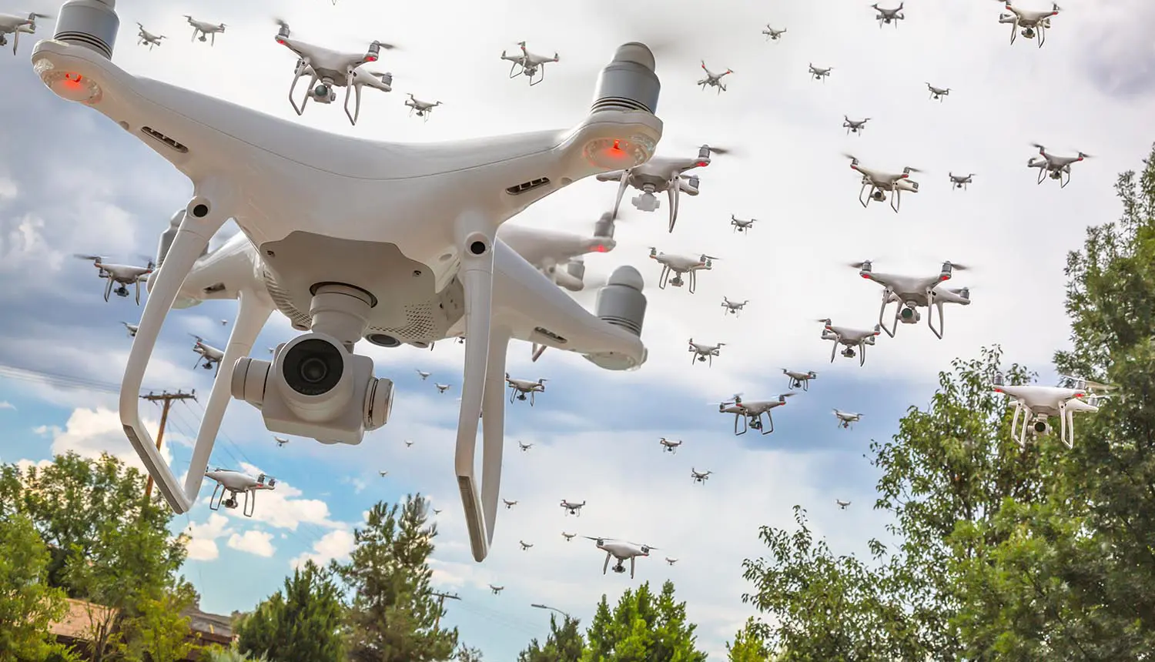
Scope Of Project
1.) Military:
It can be used in the field to control drones for surveillance without carrying a bulky remote control instead the individual will have a small glove like wearable device enabling them to have greater mobility and efficiency.

Slide 6

Scope Of Project
2.) Medical Assistance:
There are millions of people struggling to move on their on or move things in their vicinity. This proposed device can help these people in moving without having to do complex movements thus saving them from tedious tasks and chores.

Slide 7

Scope Of Project
3.) Logistics:
In huge industries like automotive one where there is a need to move very large objects reducing the efficiency of workers and increasing the hazard level due to the heavy loads. Our proposed system will help the workers to increase their work efficiency.

Slide 8
Technology Used
Internet Of Things:
The Internet of Things (IoT) describes the network of physical objects “things” that are embedded with sensors, software, and other technologies for the purpose of connecting and exchanging data with other devices and systems over the internet.
A thing in the internet of things can be a person with a heart monitor implant, a farm animal with a biochip transponder, an automobile that has built-in sensors to alert the driver when tire pressure is low or any other natural or man-made object that can be assigned an Internet Protocol (IP) address and is able to transfer data over a network.

Slide 9
How IOT Works
An IoT ecosystem consists of web-enabled smart devices that use embedded systems, such as processors, sensors and communication hardware, to collect, send and act on data they acquire from their environments. IoT devices share the sensor data they collect by connecting to an IoT gateway or other edge device where data is either sent to the cloud to be analyzed or analyzed locally.
Sometimes, these devices communicate with other related devices and act on the information they get from one another. The devices do most of the work without human intervention, although people can interact with the devices -- for instance, to set them up, give them instructions or access the data.

Slide 10
Hardware Description
Arduino LilyPad
The LilyPad Arduino 328 Main Board is an Arduino-programmed microcontroller designed to be easily integrated into e-textiles and wearable projects. It offers the same functionality you find in other Arduino boards, in a lightweight, round package designed to minimize snagging and profile, with wide tabs that can be sewn down and connected with conductive thread.
The LilyPad Arduino consists of an ATmega328 with the Arduino bootloader and a minimum number of external components to keep it as small (and as simple) as possible

Slide 11
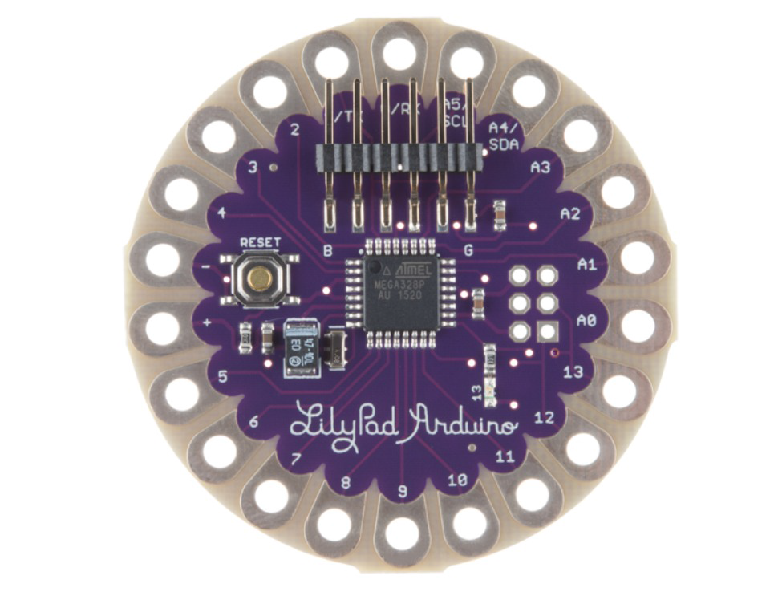
This board will run from 2V to 5V and offers large pin-out holes that make it easy to sew and connect. Each of these pins, with the exception of (+) and (-), can control an attached input or output device (like a light, motor, or switch).
LilyPad is a wearable e-textile technology developed by Leah Buechley and cooperatively designed by Leah and SparkFun. Each LilyPad was creatively designed to have large connecting pads to allow them to be sewn into clothing. Various input, output, power, and sensor boards are available. They’re even washable!

Slide 12
ADXL335 Accelerometer
The ADXL335 is a small, thin, low power, complete 3-axis accelerometer with signal conditioned voltage outputs. The product measures acceleration with a minimum full-scale range of 3 g. It can measure the static acceleration of gravity in tilt sensing applications, as well as dynamic acceleration resulting from motion, shock, or vibration.
The user selects the bandwidth of the accelerometer using the CX,
CY, and CZ capacitors at the XOUT, YOUT, and ZOUT pins. Bandwidths can be selected to suit the application, with a range of 0.5 Hz to 1600 Hz for X and Y axes, and a range of 0.5 Hz to 550 Hz for the Z axis.

Slide 13
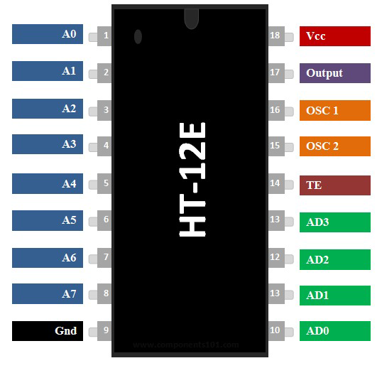
HT12E Encoder
HT12E is a 212 series encoder IC (Integrated Circuit) for remote control applications. It is commonly used for radio frequency (RF) applications. By using the paired HT12E encoder and HT12D decoder we can easily transmit and receive 12 bits of parallel data serially. HT12E simply converts 12 bit parallel data in to serial output which can be transmitted through a RF transmitter. These 12 bit parallel data is divided into 8 address bits and 4 data bits. We can provide 8 bit security code for data transmission and multiple receivers may be addressed using the same transmitter.

Slide 14
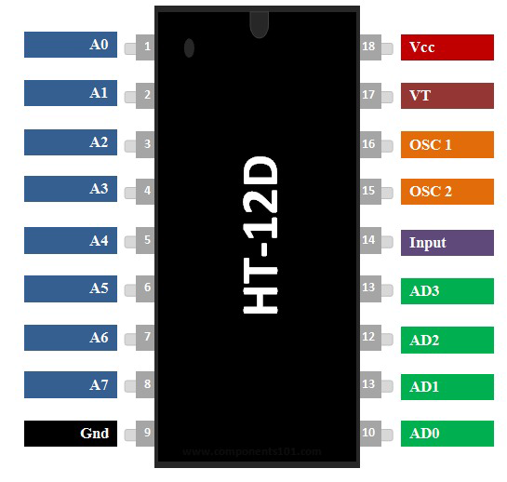
HT12D Encoder
HT12D IC is a CMOS series 12-bit RF decoder. Mostly remote control applications have this technology. It gets to interface with the third device and helps it to decode 12-bits data. In this decoder, only 4-bits are data the remaining part is the address. The address will describe the location but 4-bits combination could make 16 types of different combinations. The HT12D decoder can not work alone. It works with another counterpart called an encoder.

Slide 15
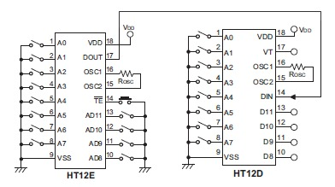
Working

Slide 16
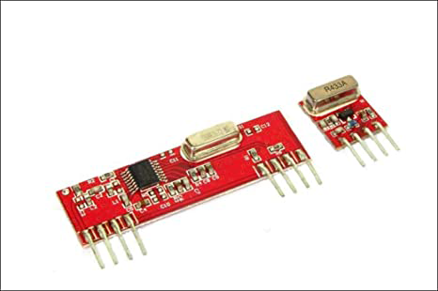
RF433 Module
The RF module, as the name suggests, operates at Radio Frequency. The corresponding frequency range varies between 30 kHz 300 GHz. In this RF system, the digital data is represented as variations in the amplitude of carrier wave. This kind of modulation is known as Amplitude Shift Keying (ASK).
Transmission through RF is better than IR. Firstly, signals through RF can travel through larger distances making it suitable for long range applications.

Slide 17
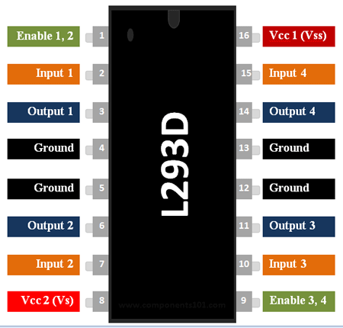
L293D Motor Driver
The L293D is a popular 16-Pin Motor Driver IC. As the name suggests it is mainly used to drive motors. A single L293D IC is capable of running two DC motors at the same time; also the direction of these two motors can be controlled independently. So if you have motors which has operating voltage less than 36V and operating current less than 600mA, which are to be controlled by digital circuits like Op-Amp, 555 timers, digital gates or even Micron rollers like Arduino, PIC, ARM

Slide 18
Working Flow
Transmitter
Transmitting section is comprised of four parts such as Accelerometer,
Microcontroller, Encoder and Transmitter Module. The Accelerometer is an electromechanical device that measures the acceleration of an object across 3-axis or multiple axis. It detects position, velocity, vibration and orientation of an object. Here we have used ADXL335, which provides X, Y, Z co-ordinate of the associated Object. The X and Y co-ordinate are used in this work to detect the gesture which is fed to the microcontroller.The Accelerometer’s X-pin and Ypin are connected to VCC or the power supply.The pin number a0,a1 as well as the ‘+’ and ‘-’ pin of lilypad are connected to 0 Volt. We have used Arduino Lilypad where Atmega 328P has been used as the microcontroller.

Slide 19
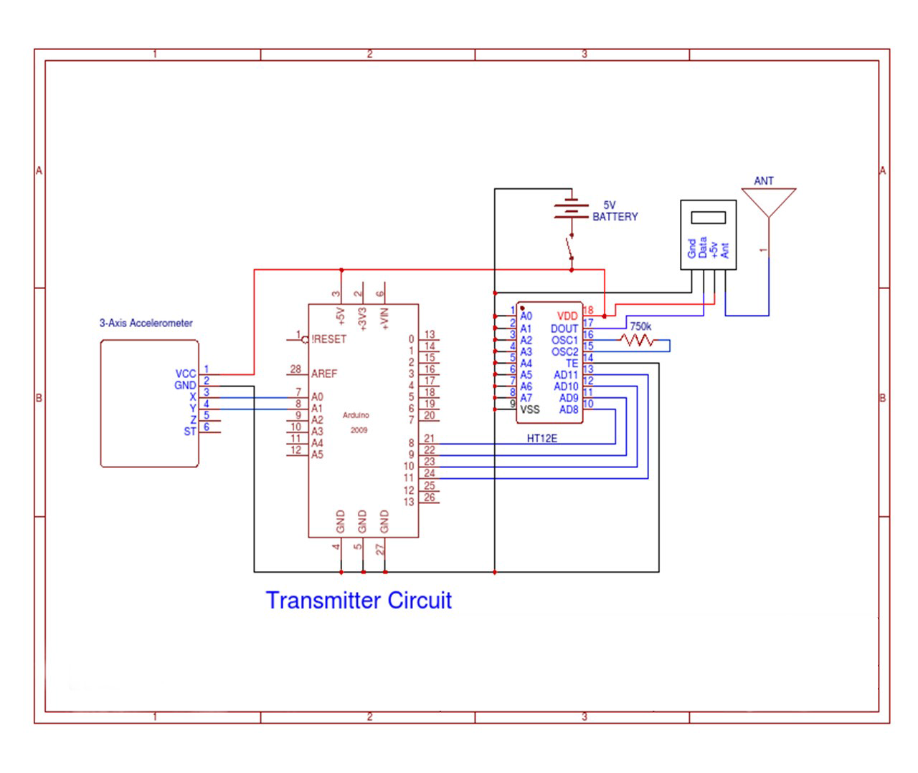

Slide 20
Receiver
The receiving section is comprised of 5 parts such as Receiver Module, Decoder,Motor Driver IC,Voltage Regulator and DC Motor. The receiver module receives the analog signal from the transmitter and sends it to the decoder through ‘DATA’ pin.We have used HT12D in our project. As we have kept the address bits of the encoder to low state, we have connected the address pins of the decoder to ground.
The serial data received from the receiver module is first compared with the local address bits and if it gets matched, then only the received data get decoded. It converts the analog signal to digital signal and sends it to the motor driver IC.

Slide 21
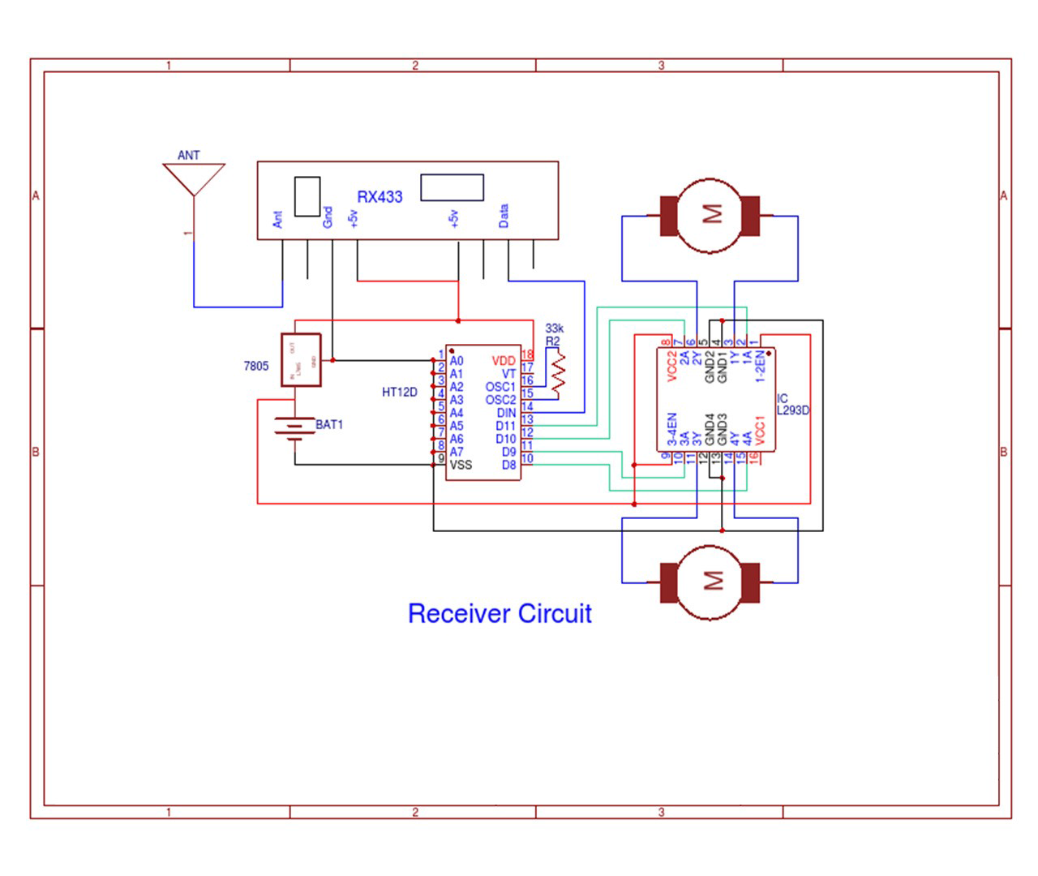

Slide 22
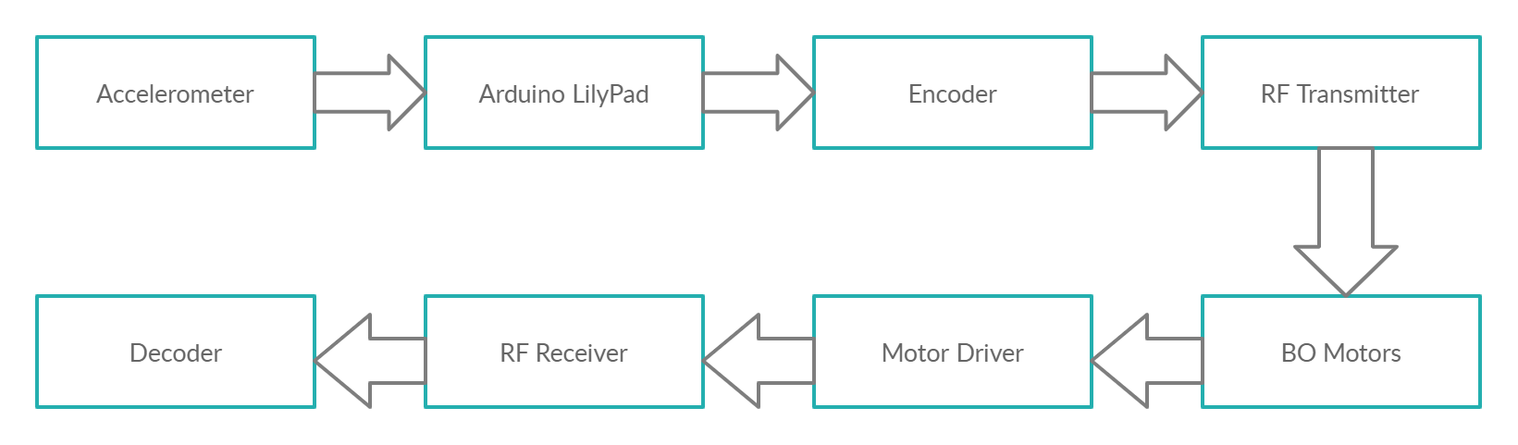
Flow Of Data

Slide 23
Future Scope
Radiation Detection
It is a major problem that whenever there is some incident involving
radiation leak, it is really risky for human beings to go in those environments
and investigate. That’s where this proposed system can be
of use.
The car can be installed with with a camera, some sensors connected
to a raspberry pie which can continuously stream live data to
some interface accessible by users from far away in safety. Services
offered by AWS can be used to implement efficiently and in minimal
cost.

Slide 24
Reference
[1] R. K. Megalingam, S. Sreekanth, A. Govardhan, C. R. Teja and A.
Raj, ”Wireless gesture controlled wheelchair,” 2017 4th International
Conference on Advanced Computing and Communication
Systems (ICACCS), Coimbatore, 2017
[2]Vishal V. Pande, Nikita S.Ubale, Darshana P. Masurkar, Nikita R.
Ingole, Pragati P. Mane “Hand Gesture Based Wheelchair Movement
Control for Disabled Person Using MEMS.”Int. Journal of
Engineering Research and Applications , ISSN : 2248 9622, Vol.
4, Issue ( Version ), April 2014
[3]http://www.sensorwiki.org/doku.php/sensors/accelerome ter
[4]https://components101.com/
[5]https://www.instructables.com/id/How-to-Program-a-LilyPad-
Without-FTDI-Converter/

Slide 25
Thanks!
Any questions?

